Slide 1

Electric vehicle market analysis
Best Cities in the US to own & operate electric vehicles
Andrew Perez
Brent Meulebroek
Michael Badinger
Gary Jeter

Slide 2

Executive Summary
Questions & Factors
Manufacturers and consumers both have an interest in understanding which are the best cites to own & operate a plug-in electric vehicles (PEV). Consumers want confidence in their investments. Manufacturers want to target the best markets.
Analysis Methodology
Research PEV and factors (population, climate conditions, sufficient PEV infrastructure)
APIs to pull available data
Detailed analysis of factors using Python scripting and graphs
Interpret results & recommend top cities
Analysis Results
84 cities based on population
70 cities based on weather
20 cities based on infrastructure
Recommendation
11 cities in CA
4 cities in TX
2 cities in CO
2 cities in FL
1 city on OR

Slide 3

Questions & Data
Question | Data
Which cities have the optimal weather conditions for plug-in electric vehicles (PEV)? | Open Weather API (http://api.openweathermap.org)
Which cities have the best infrastructure to support PEVs? | Open Charge Map API (https://openchargemap.org/site/develop/api)
Which cites have a large enough population to provide consumer confidence in PEV support and services? | Census Python Library API (2018 Data) Google Maps API (maps.googleapis.com/maps/api)

Slide 4
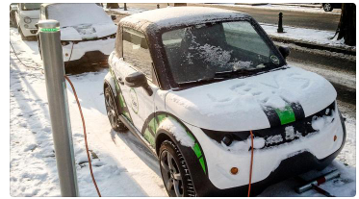
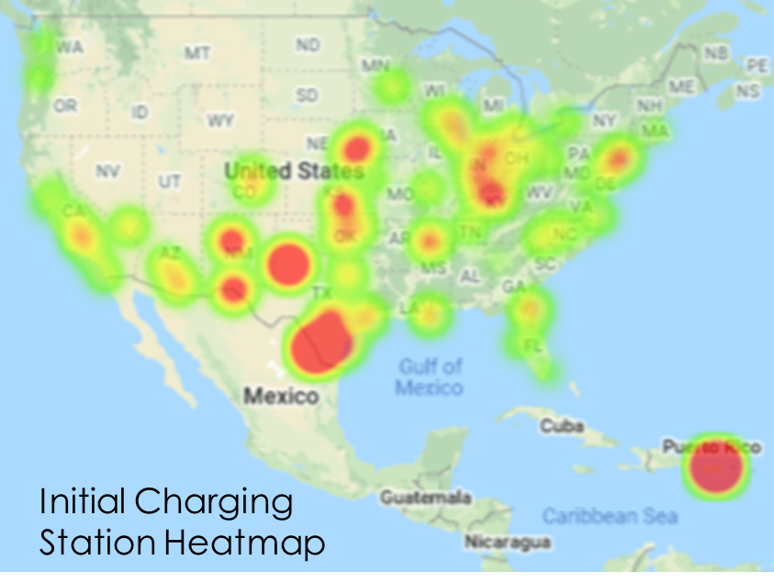
Data Clean Up & Exploration
PEV Research
Best & Worst places for PEVs
Capabilities & limitations
Insights
Most US cities weather conditions support PEVs
Populations greater than 250K are best
Charging Station infrastructure is rapidly growing!
PEV owners should move to Puerto Rico ☺
Rabbit holes
Commute time
Average gas prices
PEV State & Federal Incentives & Regulations

Slide 5
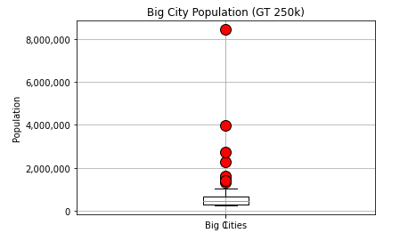
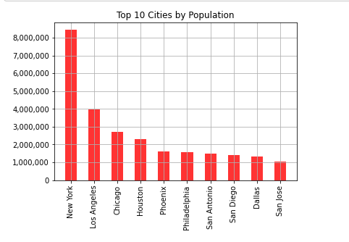
Census Analysis
Method:
Census Library API
250K population screening criteria based on market size
Box plot identified outliers exist
Bar chart identified outlier cities
No removal of outlier cities due to market size opportunity for manufacturers
Results: Reduced scope to 84 cities

Slide 6
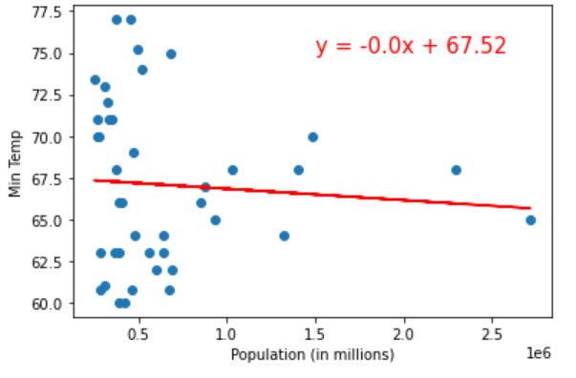
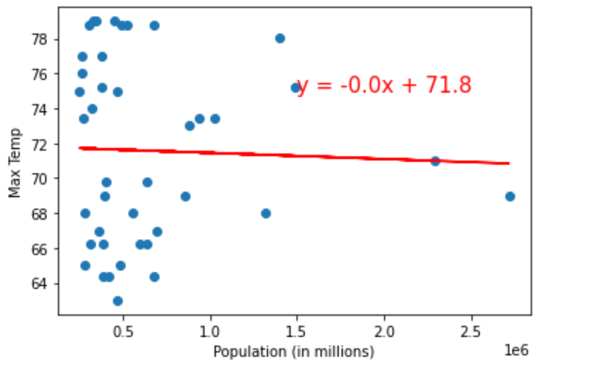
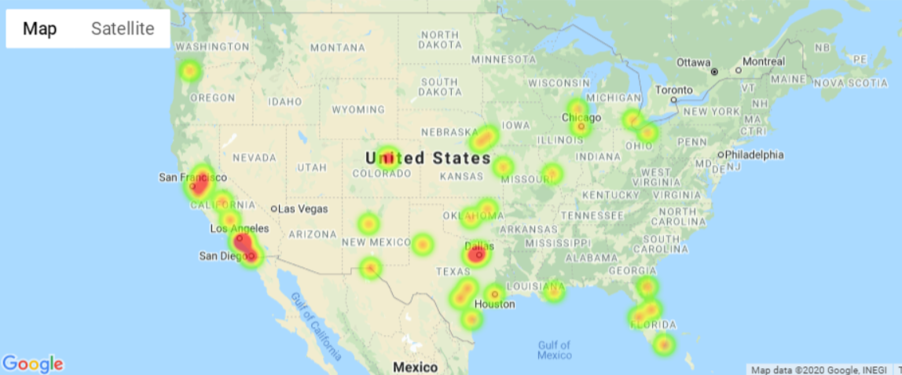
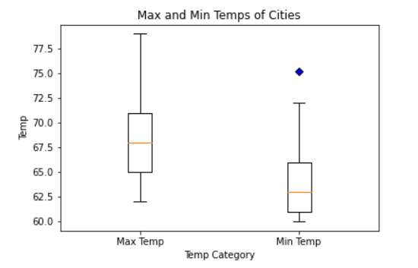
Weather Analysis
No Correlation between pop & temp
Method:
Open Weather API
No Correlation between Temp & Population (R-sq .001 & .005)
Box plot reflected minimal outliers
Research identified optimal temperatures *
Max Temp < 115 degrees F
Min Temp > 40 degrees F
Results: Reduced scope to 70 cities
Kept the outlier within recommended temperature range
* source: https://www.sciencemag.org/news/2015/02/best-and-worst-places-drive-your-electric-car

Slide 7
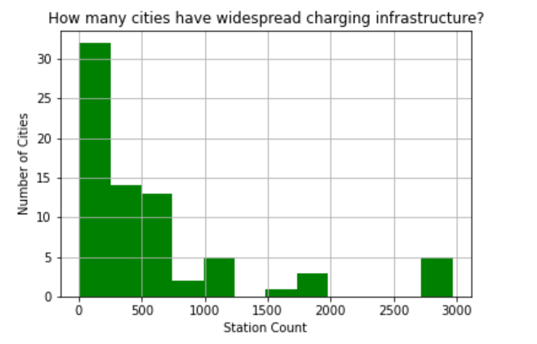
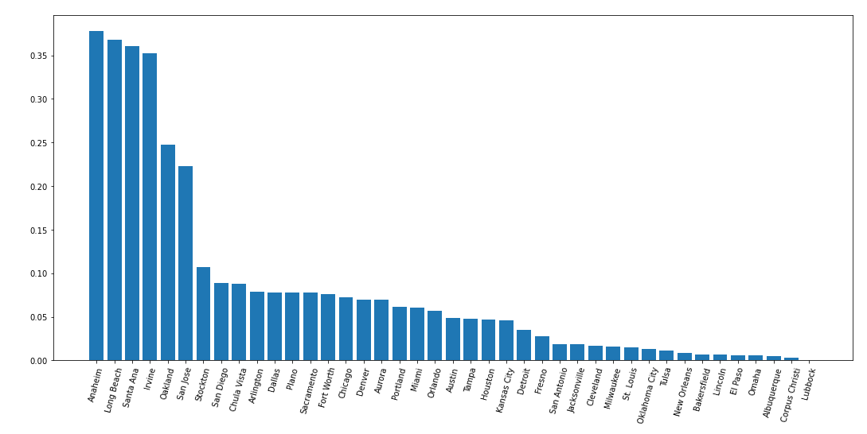
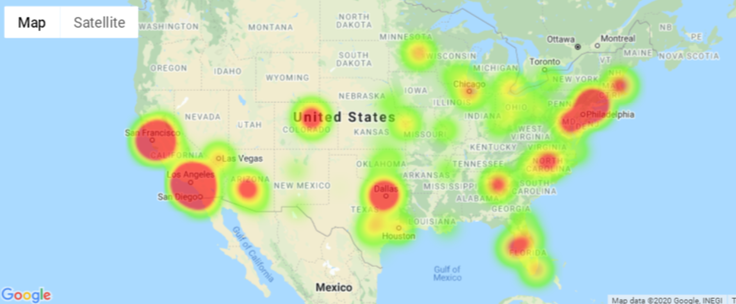
Charging Station Analysis
Method:
Open Charge API
Skewed distribution of count of stations shows ~5 cites > 2.5K stations
Bar chart identified Southern CA has highest charging stations per mile
Heatmap shows raw count of charging stations & East Coast as areas of interest
California - Top 9
Station Density

Slide 8
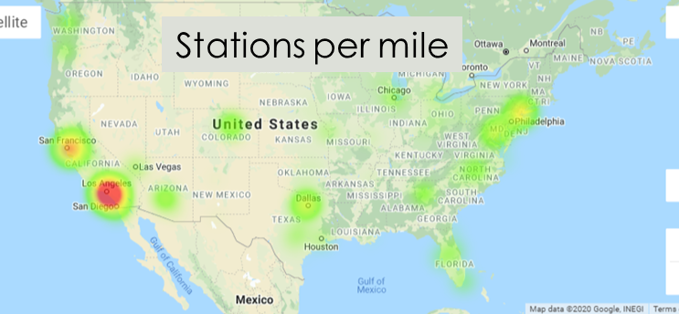
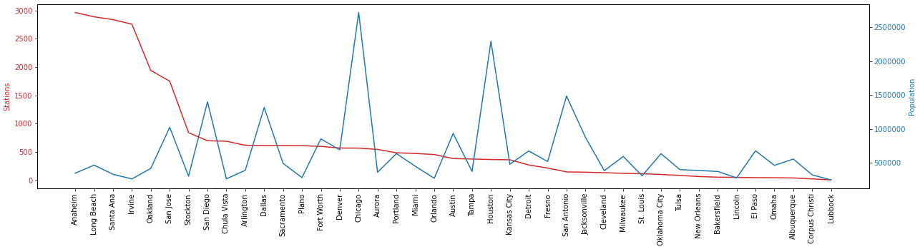
Charging Station Analysis
Method:
Heatmap on station density (stations per mile) brings out LA area with highest density
Population & count of stations identified most desirable cities
Results: Identified top 20 cities
Good Gap
Lots of stations & lower population!
Bad Gap
Less stations &higher population!

Slide 9
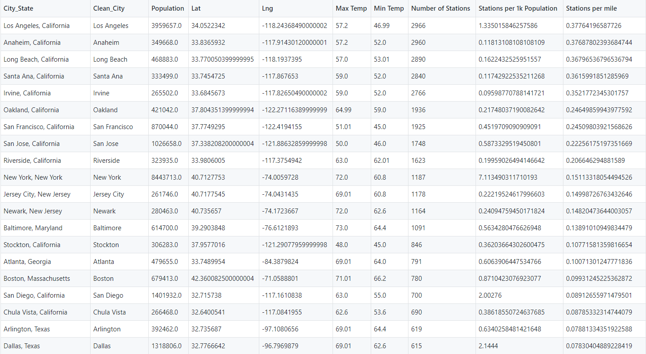
Top 20 Cities

Slide 10
Post-Mortem
Pros | Opportunities
Learned a lot about PEVs | Access to data limited analysis opportunities. Data at state only vs city, etc.
Use of GitHub made it easy to divide up work & merge work | Census API data is messy & a wealth of information available!
Great team & collaboration | GitHub growing pains – Common Kernels, set-up, merging branches, etc.
 | Open Charge API crashed PC with 500 MB query
 | The time of day when running the script changes the results since the Open Weather API uses current temperature. Future analysis would want historical temperatures.

Slide 11


